Slide 1
Data Loss Prevention (DLP)

Slide 2
Contents:
1. Data Loss Prevention (DLP)
2. Introduction to DLP
3. Email Attachment Control
4. Browser Data Upload Restrictions
5. Device & Network Data Restrictions
6. Restricted Application Notifications
7. User Behavior Analytics (UBA)
8. Chat File Upload Restrictions
9. File Transfers via FTP/SCP
10.User Behavior Analytics Monitor Activities
11. User Activity Monitoring
12. Screenshots & Camera Capture
13. Productivity Classification
14. DLP Policy Actions
15. Data Protection & Reporting

Slide 3

Data Loss Prevention (DLP)
Subtitle: Ensuring Secure Data Handling and Compliance Your Company Name & Date

Slide 4

Introduction to DLP
Definition
Data Loss Prevention (DLP) is a strategy to prevent
unauthorized access, sharing, or transfer of sensitive data.
Importance
Helps organizations protect confidential data and
ensure compliance with security policies.

Slide 5
Email Attachment Control
1.Notify Users
Notify users when sending attachments via email.
2.Configurable Alerts
Provide configurable alerts for sensitive data.
3.Control Actions
Implement control actions: allow, warn, block.

Slide 6
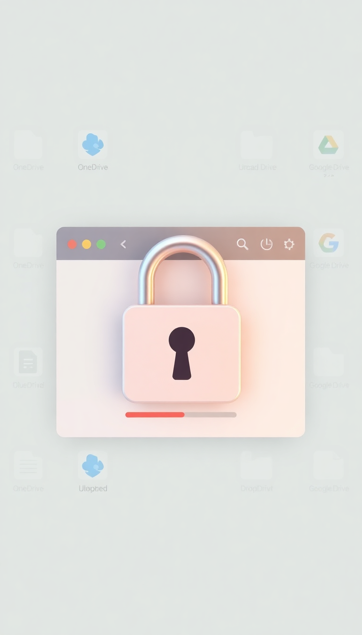
Browser Data Upload Restrictions
Restrict Services
Restrict data uploads to cloud storage services:
OneDrive, Dropbox, Google Drive, SharePoint, other
web file transfer platforms.

Slide 7
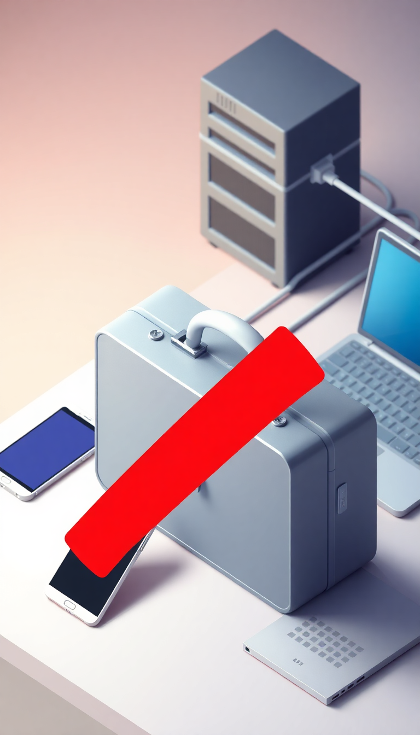
Device & Network Data Restrictions
Prevent Sharing
Prevent data sharing via: USB drives, Bluetooth,
printing, network sharing.

Slide 8
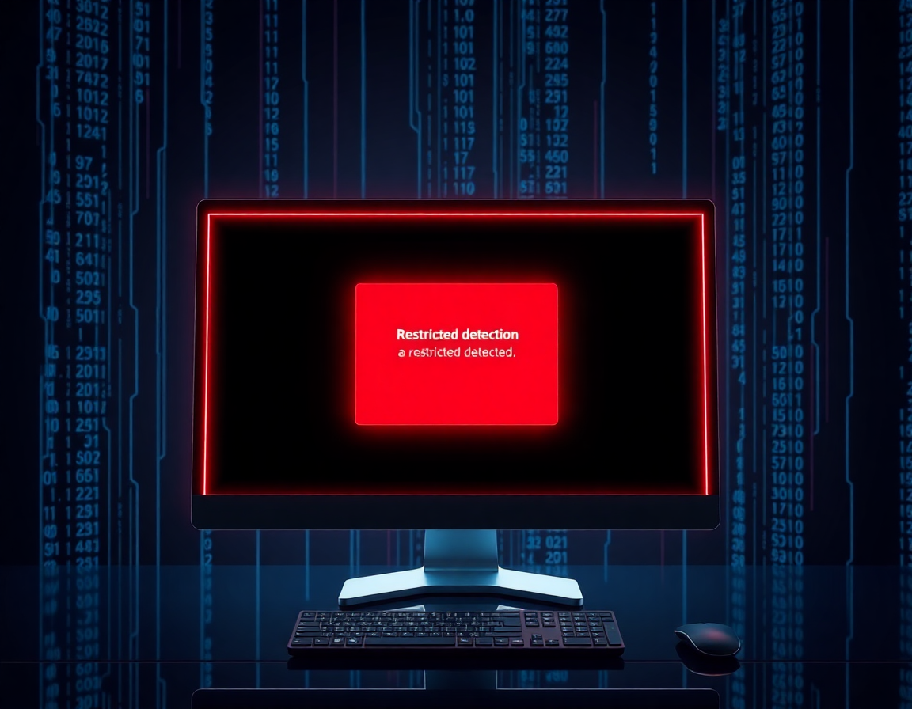
Restricted Application Notifications
Detect & Notify
Detect and notify users if restricted applications
are installed on their system.
Prevent Execution
Prevent execution of unauthorized software

Slide 9
User Behavior Analytics (UBA)

Slide 10
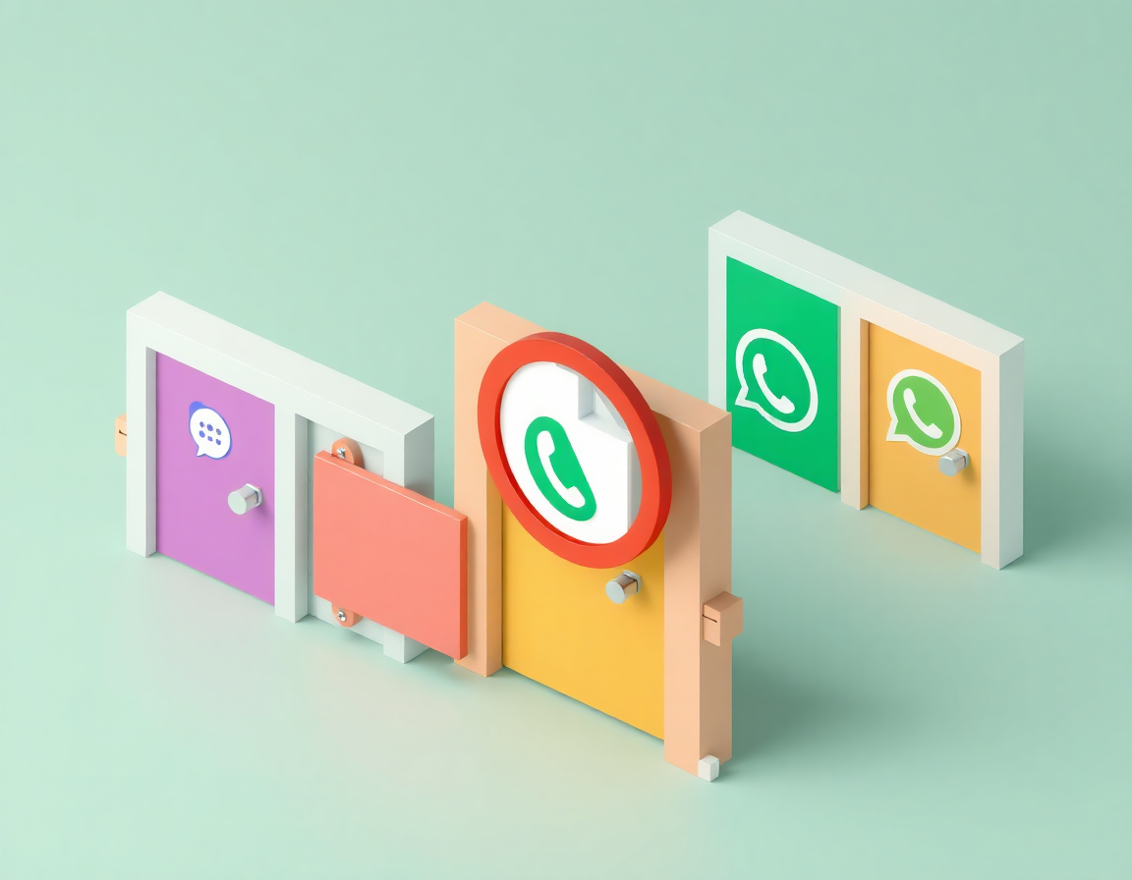
Chat File Upload Restrictions
Monitor & Restrict
Monitor and restrict file uploads in: Zoom,
Google Meet, Skype, Teams, WhatsApp.

Slide 11
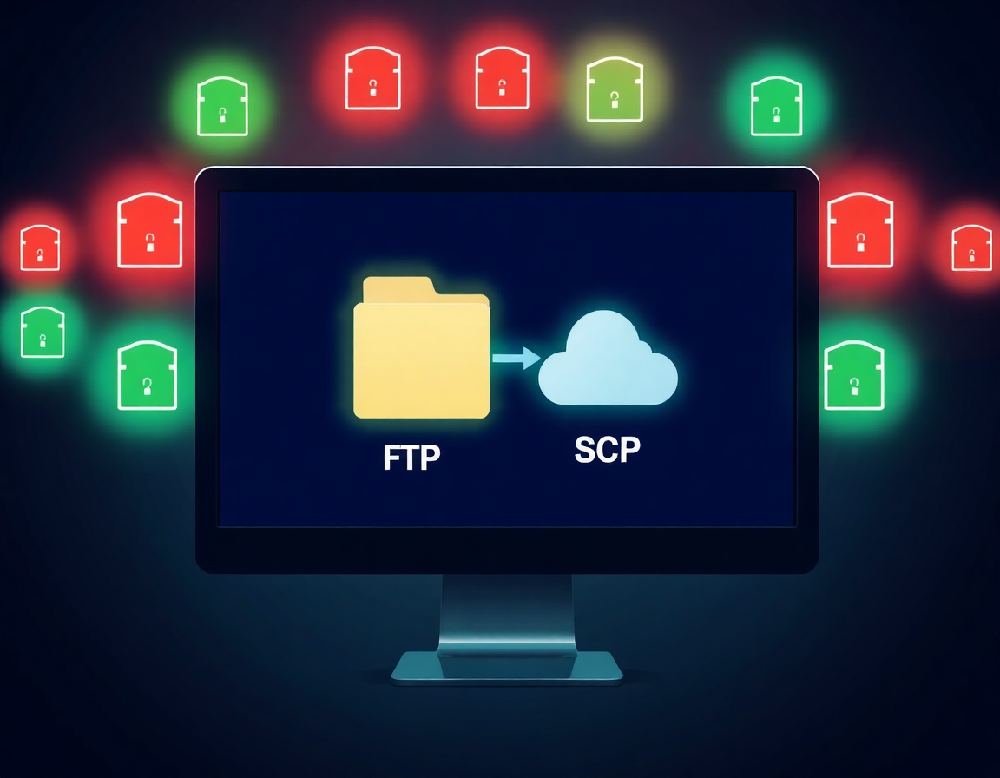
File Transfers via FTP/SCP
Monitor & Control
Monitor and control data transfers using:
FTP, SCP (MobaXterm).

Slide 12

User Behavior Analytics Monitor Activities
Detect Anomalies
Detect anomalies and unauthorized
data access.
Monitor Activities
Monitor user activities to prevent potential
threats.

Slide 13
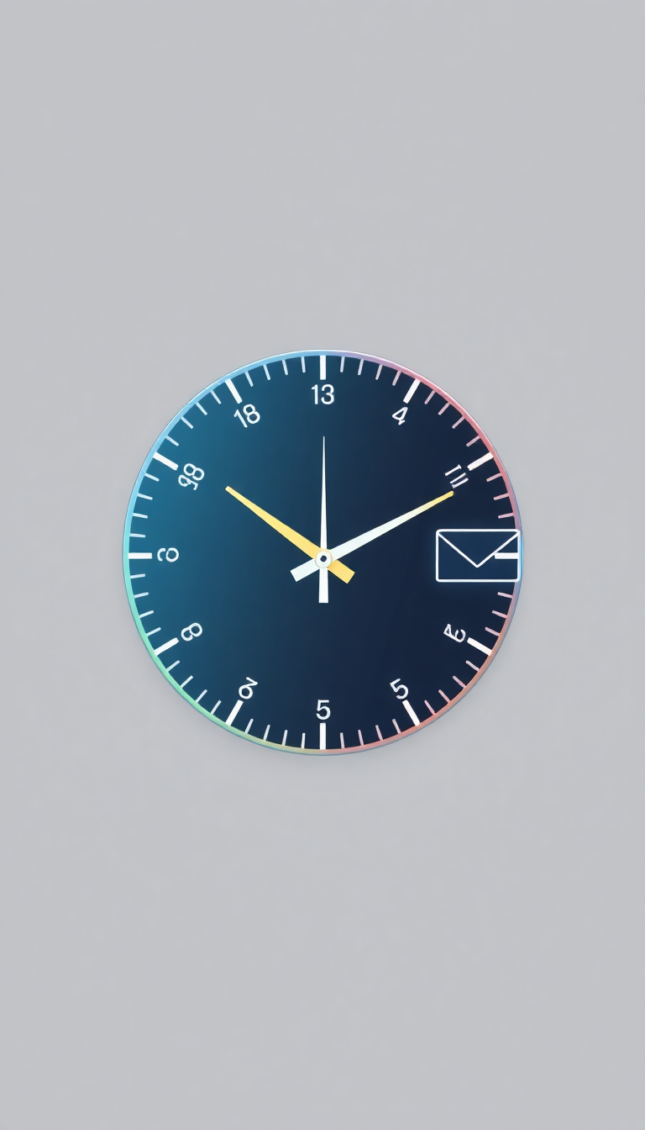
User Activity Monitoring
Track Productivity
Track remote worker productivity hours.
Application Usage
Application usage monitoring (e.g., VLC player and others).
Email Logging
Log all incoming and outgoing email communications.

Slide 14
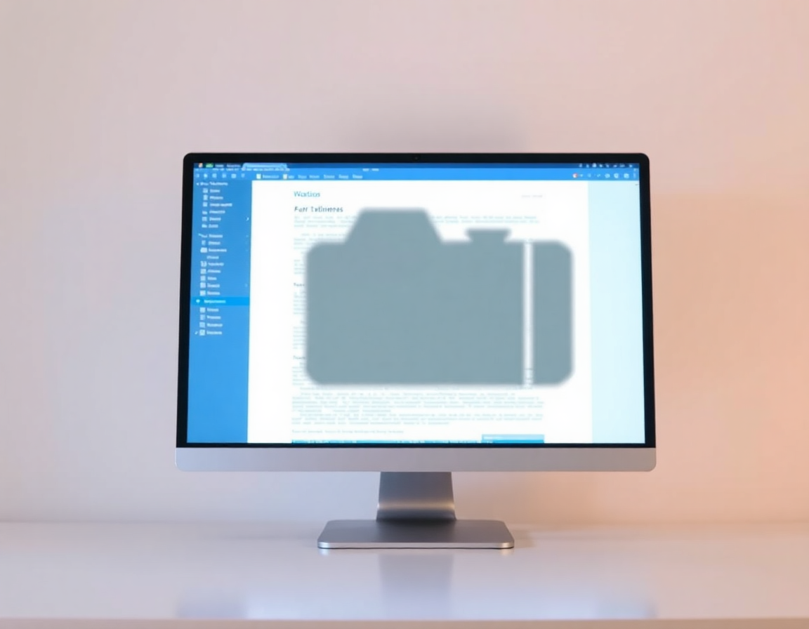
Screenshots & Camera Capture
Periodic Screenshots
Periodic screenshots for activity monitoring.
Camera Snapshots
Configurable intervals for camera snapshots.

Slide 15

Productivity Classification
Define Application Types
Define and configure application types:
Productive (e.g., Office tools, IDEs),
Non-Productive (e.g., Social media, games).

Slide 16
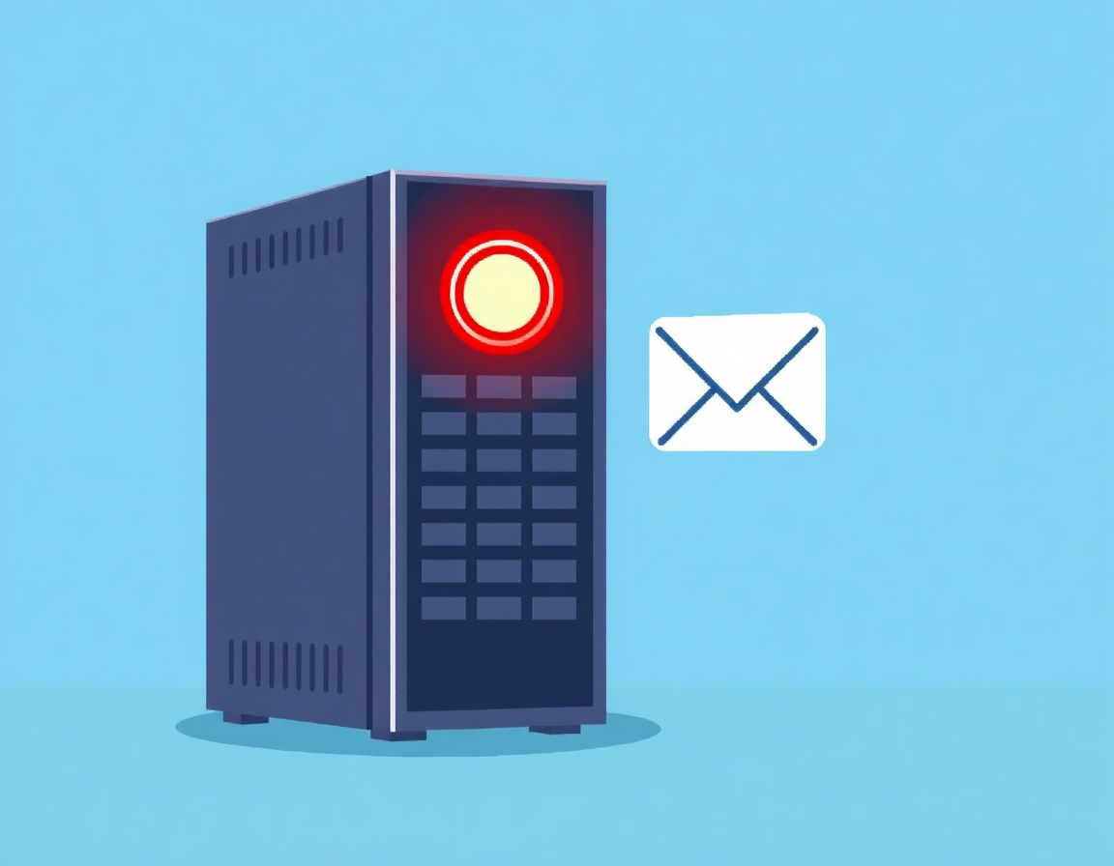
DLP Policy Actions
Policy Options
Record only, notify, justify, block.
Policy Violations
Immediate email notifications for policy
violations.

Slide 17
